Slide 1
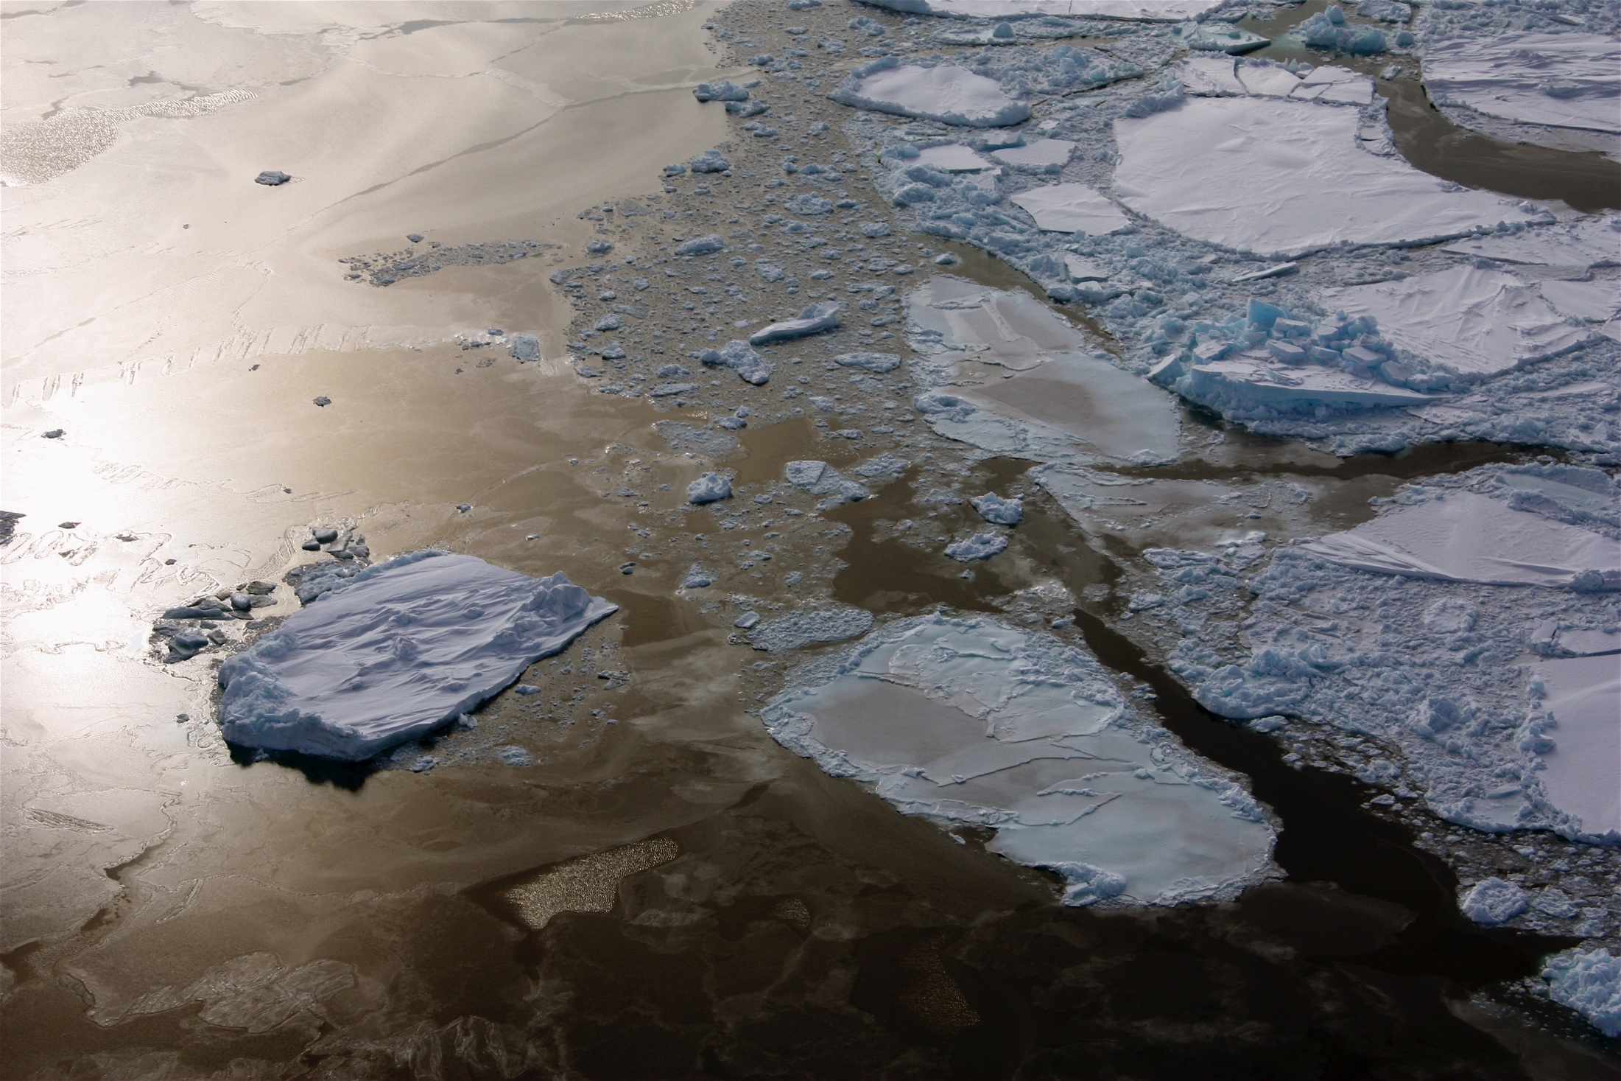

Communicating why sea ice matters:
Efforts of the SEARCH Sea Ice Action Team
SEARCH Planning Meeting
Seattle, Washington
November 19, 2015

Slide 2
SIAT Communication Strategy
Key Elements
  Collaboratively develop concise and accessible sea ice information, organized across high-level topics (“Sea Ice and…”)
  Facilitate guest perspectives from science & stakeholder communities
  Provide tiered access to info. via a hierarchical, pyramid structure
  Provide timely scientific information (via Rapid Response Teams) in response to emerging high-interest topics
  Evaluate the usability and usefulness of provided information
A web resource – Sea Ice Matters – will provide a platform for multi-media information and a focus for collaboration.

Slide 3
SIAT Communication Strategy
Key Elements
  Collaboratively develop concise and accessible sea ice information, organized across high-level topics (“Sea Ice and…”)
  Facilitate guest perspectives from science & stakeholder communities
  Provide tiered access to info. via a hierarchical, pyramid structure
  Provide timely scientific information (via Rapid Response Teams) in response to emerging high-interest topics
  Evaluate the usability and usefulness of provided information
A web resource – Sea Ice Matters – will provide a platform for multi-media information and a focus for collaboration.

Slide 4
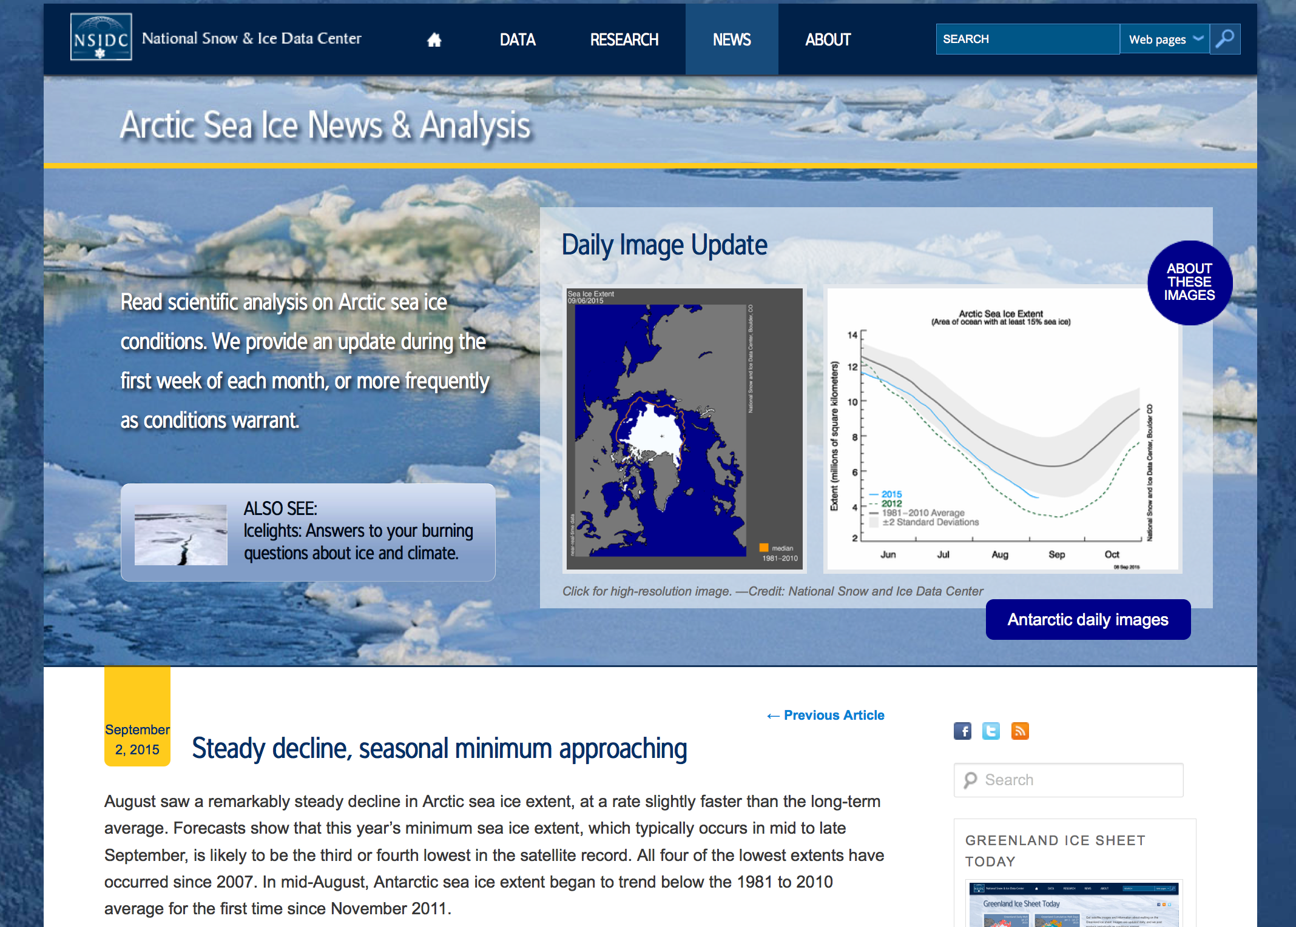

Slide 5
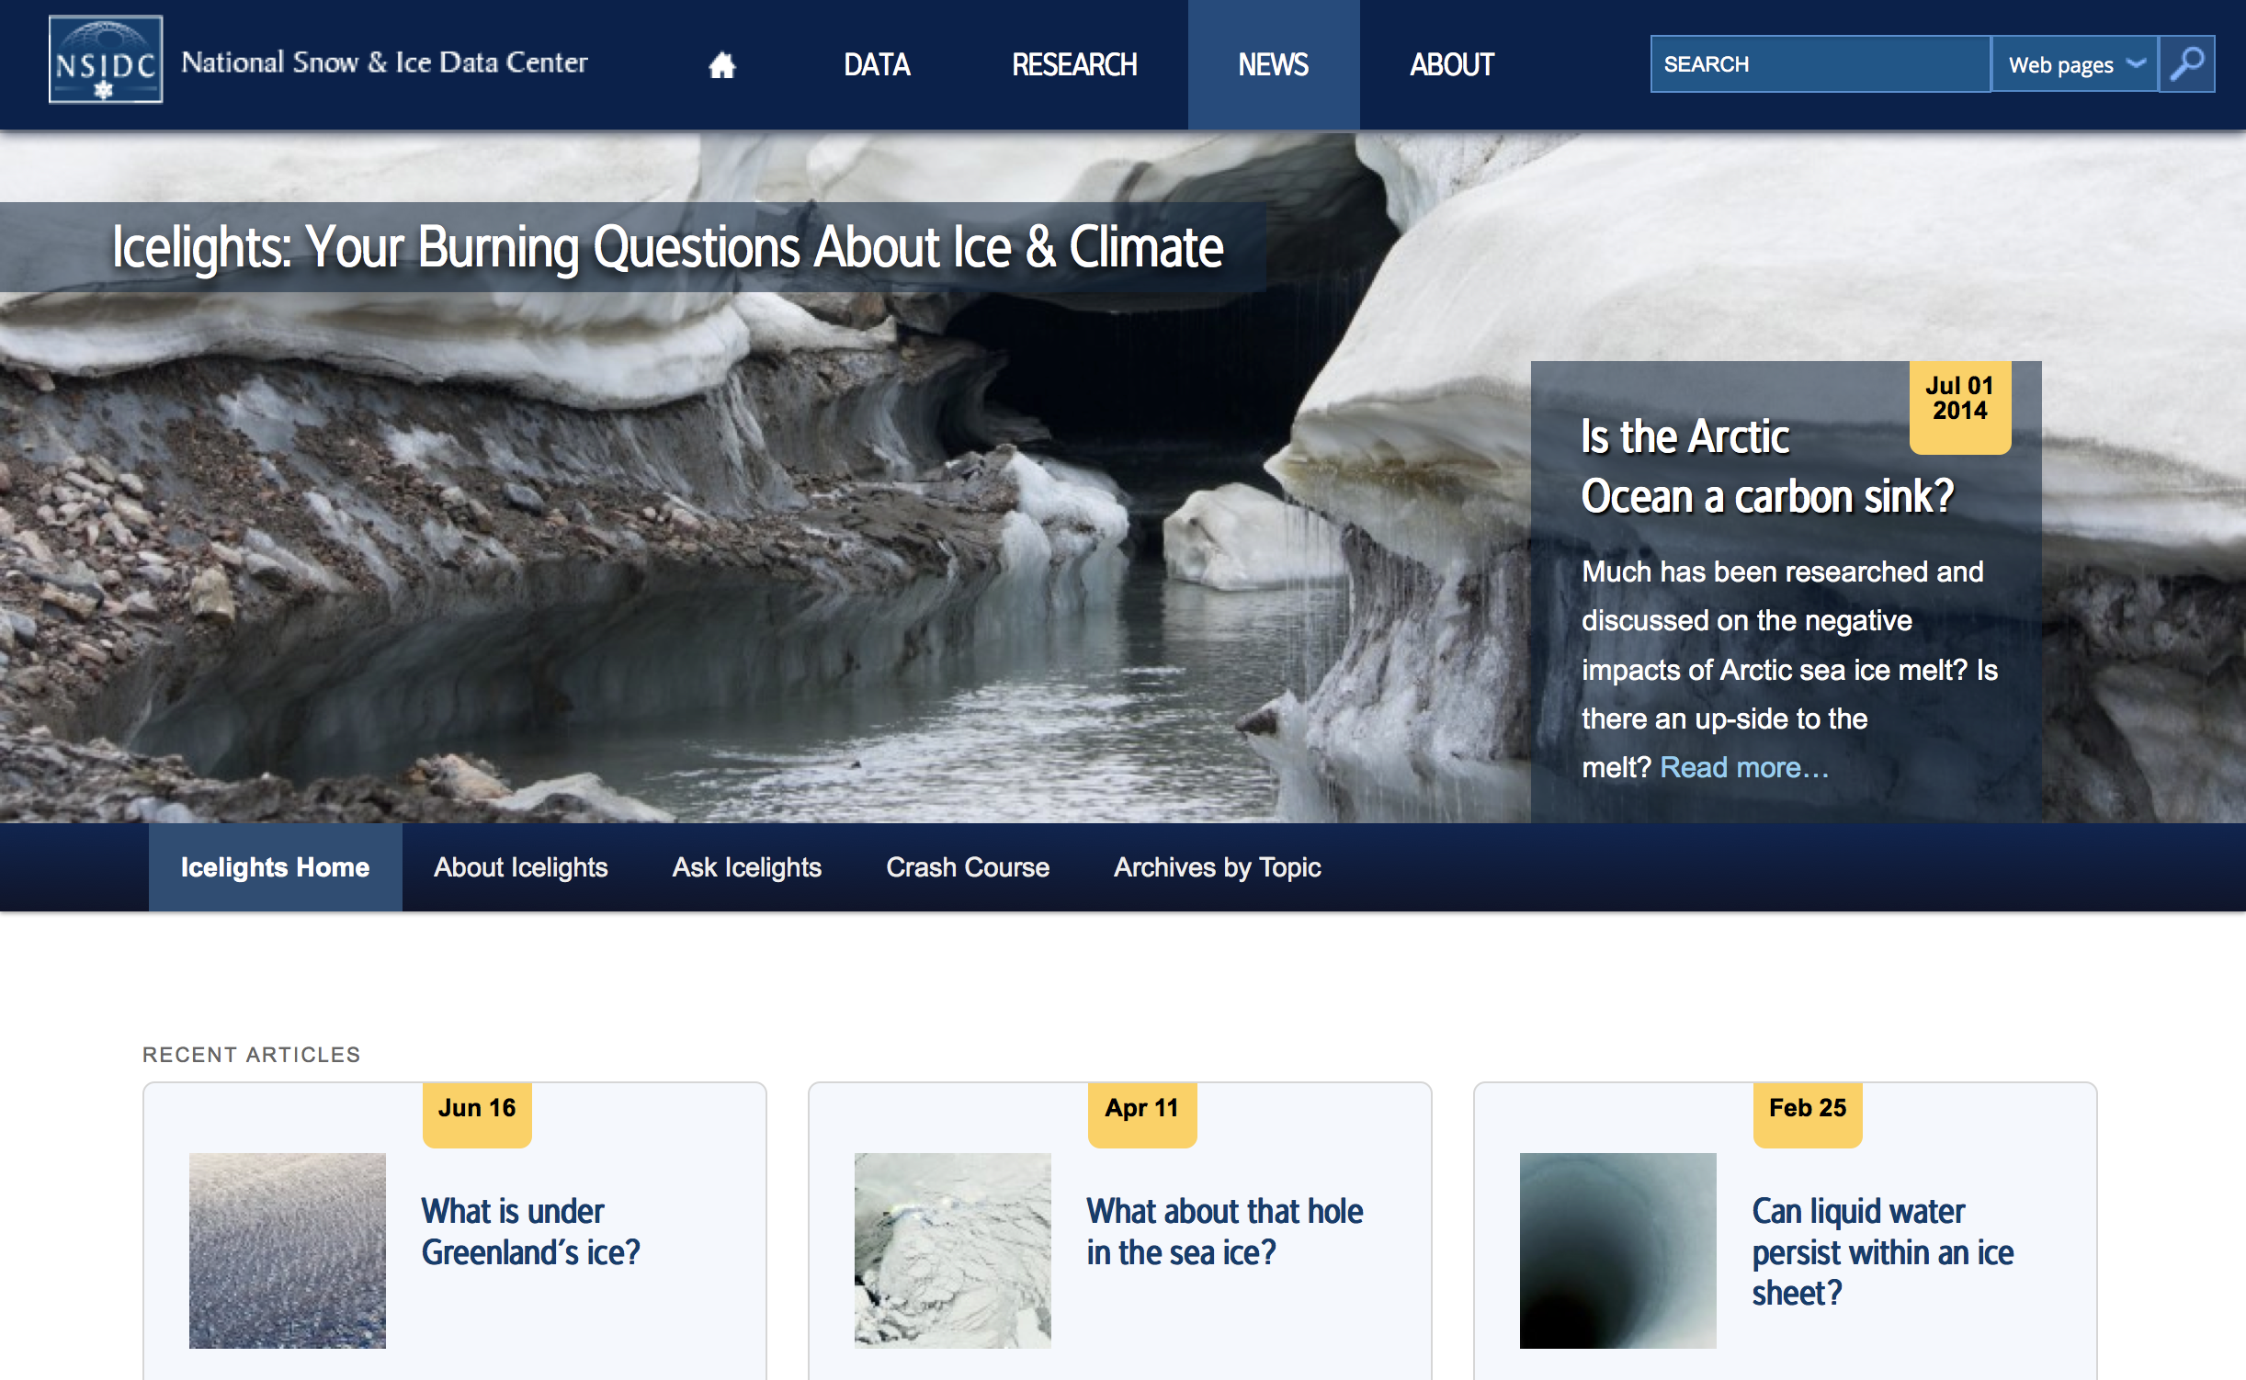

Slide 6
SIAT Communication Strategy
Key Elements
  Collaboratively develop concise and accessible sea ice information, organized across high-level topics (“Sea Ice and…”)
  Facilitate guest perspectives from science & stakeholder communities
  Provide tiered access to info. via a hierarchical, pyramid structure
  Provide timely scientific information (via Rapid Response Teams) in response to emerging high-interest topics
  Evaluate the usability and usefulness of provided information
A web resource – Sea Ice Matters – will provide a platform for multi-media information and a focus for collaboration.
Notes:
High on the list
Communication as discussion

Slide 7
SIAT Communication Strategy
Key Elements
  Collaboratively develop concise and accessible sea ice information, organized across high-level topics (“Sea Ice and…”)
  Facilitate guest perspectives from science & stakeholder communities
  Provide tiered access to info. via a hierarchical, pyramid structure
  Provide timely scientific information (via Rapid Response Teams) in response to emerging high-interest topics
  Evaluate the usability and usefulness of provided information
A web resource – Sea Ice Matters – will provide a platform for multi-media information and a focus for collaboration.

Slide 8
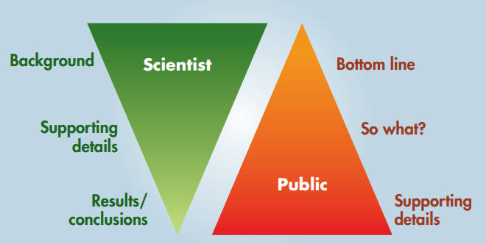
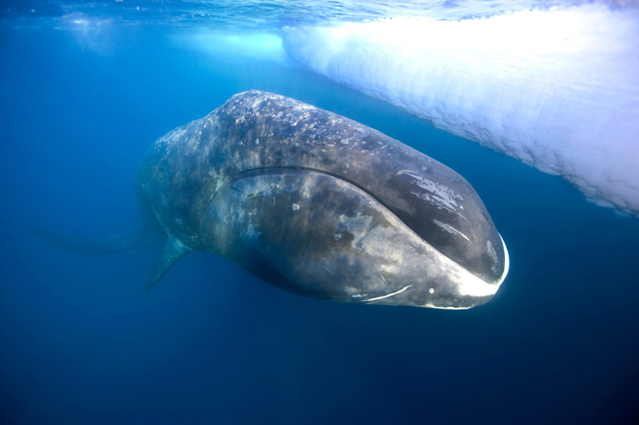
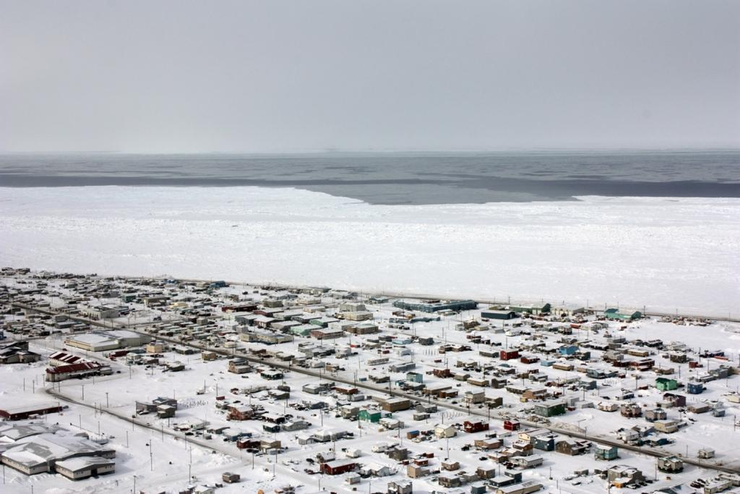
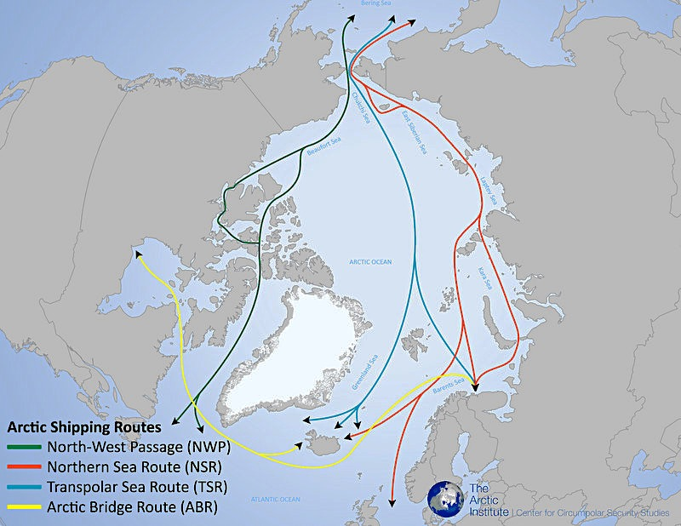
Inverting the communication pyramid
(Somerville and Hassol 2011)
Notes:
Sophisticated bottom-line messages – with scientific evidence but also stakeholder realities.

Slide 9
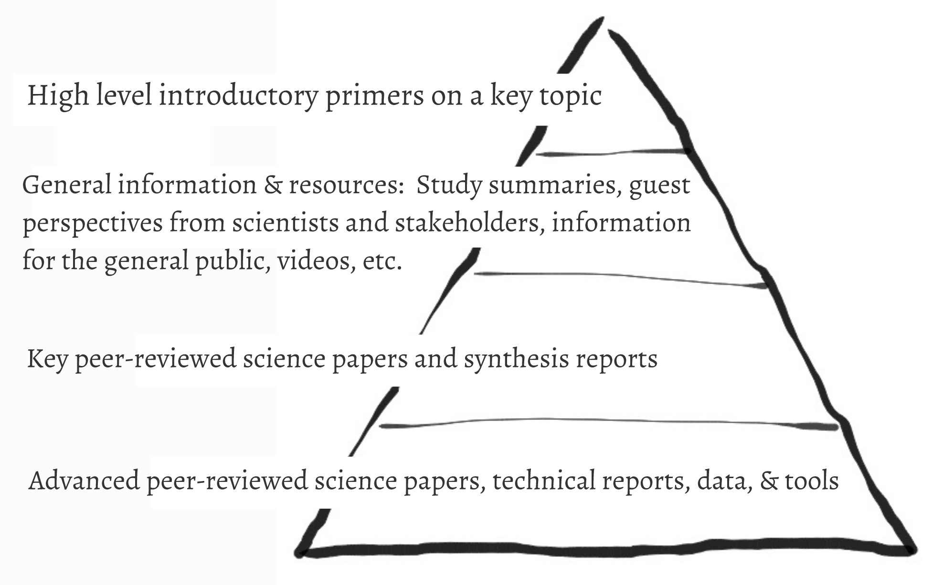
Inverting the communication pyramid

Slide 10
One Pagers
Notes:
One pagers to establish communication pathways and relationships.

Slide 11

One Pagers
Notes:
Need for a brand.

Slide 12
Key Societal Topics:
Arctic Navigation
Ocean Currents
Climate Variability
Your Weather
Coastal Communities
Ecosystems
International Security
Natural Resources
Sea Level Rise
Forecasting and Prediction
Permafrost
Environmental Stewardship
International Relations

Slide 13
SIAT Communication Strategy
Key Elements
  Collaboratively develop concise and accessible sea ice information, organized across high-level topics (“Sea Ice and…”)
  Facilitate guest perspectives from science & stakeholder communities
  Provide tiered access to info. via a hierarchical, pyramid structure
  Provide timely scientific information (via Rapid Response Teams) in response to emerging high-interest topics
  Evaluate the usability and usefulness of provided information
A web resource – Sea Ice Matters – will provide a platform for multi-media information and a focus for collaboration.

Slide 14
SIAT Communication Strategy
Key Elements
  Collaboratively develop concise and accessible sea ice information, organized across high-level topics (“Sea Ice and…”)
  Facilitate guest perspectives from science & stakeholder communities
  Provide tiered access to info. via a hierarchical, pyramid structure
  Provide timely scientific information (via Rapid Response Teams) in response to emerging high-interest topics
  Evaluate the usability and usefulness of provided information
A web resource – Sea Ice Matters – will provide a platform for multi-media information and a focus for collaboration.

